Slide 1
Introduction to Timekeeping
The aim of this PowerPoint presentation is to give you the confidence to make your first step in volunteering to be a timekeeper.
It covers the topics of :-
Consistent Reaction to a signal
Anticipation
The race (start and finish)
The track positions for race starts
Relevant timekeeping duties
Relevant parts of the Timekeepers’ Code of Practice
Press any key at any time to move on

Slide 2
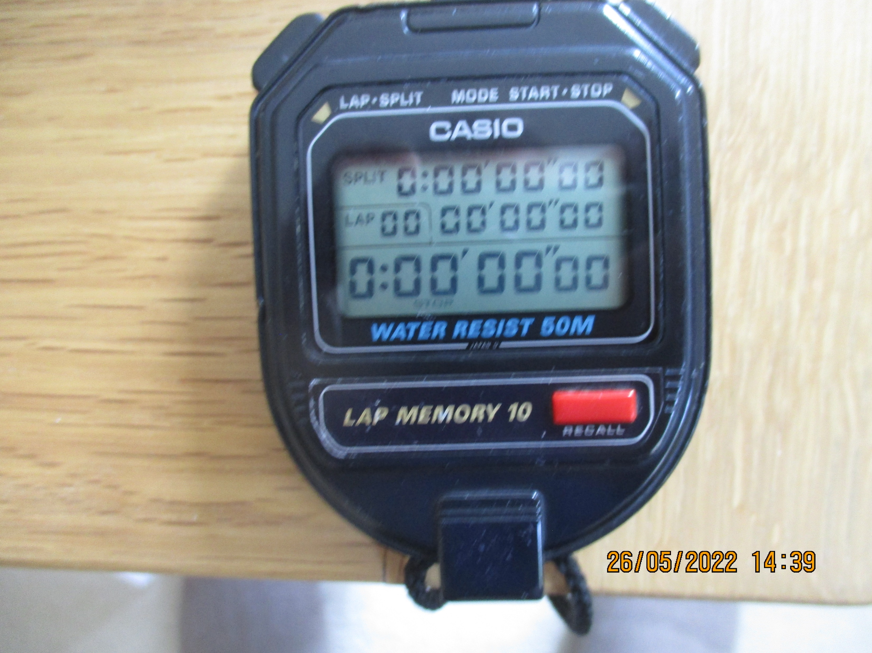
A consistent reaction to a clear signal
The following little exercise will show you if you have the consistent reaction to a clear signal necessary to be a competent timekeeper.
Cover the three zero digits on the right hand side with your left thumb and start the watch with the index finger of your right hand (for those of you who are left-handed you will need to cover with right hand)
Your clear signal is when the fourth digit from the right changes from a zero to a one (ie ten seconds have elapsed, but don’t count)
As soon as you see the digit change to a one, stop the watch.

Slide 3
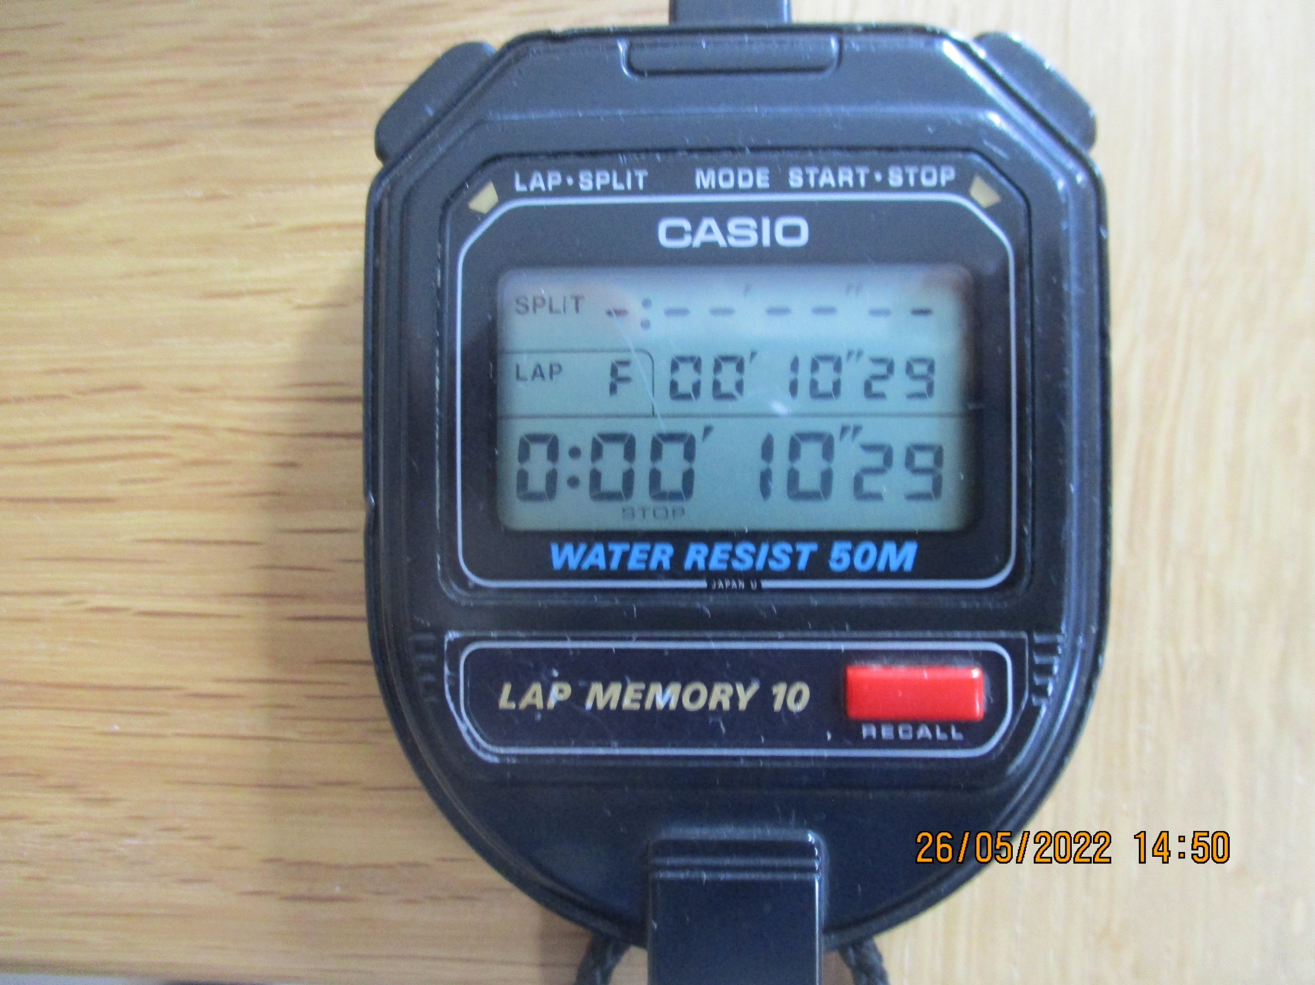
As you can see my watch says 10.29 but it doesn’t matter that yours says something different. What is important is that when you do this again it says something similar.
29 hundredths or 2.9 tenths is my reaction time to a clear signal. Normally I’m around 10.29, 10.30, 10.31 but as I said it doesn’t matter. As I have grown older my reaction time has got slightly longer.
It is the CONSISTENCY of your reaction to a clear signal that matters.
Exercise 1 : Once you have got the hang of this, do this exercise 22 times and write down your reaction times on a sheet of paper. Cross out the shortest and longest times (we all lose concentration occasionally!)
Work out the range of reaction times by taking the shortest time from the longest.
If you have what it takes to be a timekeeper this range should be 6 or under. If you are happy continue to next slide!

Slide 4
Anticipation
The bane of all timekeepers is ANTICIPATION.
We cannot anticipate the start signal but we can anticipate the athlete crossing the line because we can see them approaching.
Exercise 2
To illustrate this we are going to do the same exercise as before but this time do not cover up the other digits (so we can see the seconds ticking away towards 10 similar to the athlete approaching the finish)
As soon as you see the fourth digit, as before, change from a zero to a one stop your watch. Do this a few more times.
Are you getting the same sort of reaction times as you were getting before? If you are, well done, but the chances are that you have a shorter reaction time because you instinctively can see it arriving. This is ANTICIPATION.
Move on to the next slide

Slide 5
How to stop anticipating the finish
Every single Chief Timekeeper has their own method for explaining how to do this, from shutting your left eye to using a board to cover the finishing line. (Do not use the tick on the track!)
UKA/WA Rule 19.2 indicates that ‘the time is taken at which any part of the body of an athlete (i.e. torso, as distinguished from the head, neck, arms, legs, hands or feet) reaches the vertical plane of the nearer edge of the finish line’ (the nearer edge being nearer to the start!).
You should pinpoint a place on the white board (see more about this later) which is on the Track Judges side that is in line with the leading edge of the finish line and when the athletes torso covers that place, that is your clear signal to “Start to stop your watch”. (In the same way as the digit has changed from zero to one.)
This takes quite a time to get right so you will always tend to have a quick time to start with.
(We will come back to this later)
You need a break now so time for tea!

Slide 6
The Race (The Start)
Firstly, at the start of the meeting, the Chief Timekeeper will have given you a finishing position to time (NOT A LANE), e.g. to time the second place finisher.
There is then a protocol for the start of a race in a league match.
The starter with the cap on and a coloured sleeve will blow a whistle to the Chief Timekeeper. This is the signal that our humorous banter of our fabulous hobby must end and our concentration must begin.
The Chief Timekeeper will wave back to indicate that the Timekeepers and the Track Judges are ready.
In sprint races of 400m and less the Starter uses the commands:-
‘On your mark(s)’ ‘Set’ and fires the gun or activates the TESS system (electronic starting system).
In all races over 400m there is no ‘Set’ command, so be careful.
Sometimes there are false starts so keep alert as it can catch you out as there are no further whistles

Slide 7
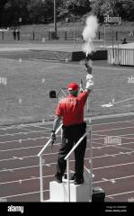
The Start
WA and UKA rule 19.7 states that :
‘The time shall be taken from the flash / smoke of the gun’
If the TESS (electronic system) is being used then the time should be taken from the flash of its light.
Note that starting on the ‘bang’ will result in you giving a fast time as sound travels more slowly than light!

Slide 8
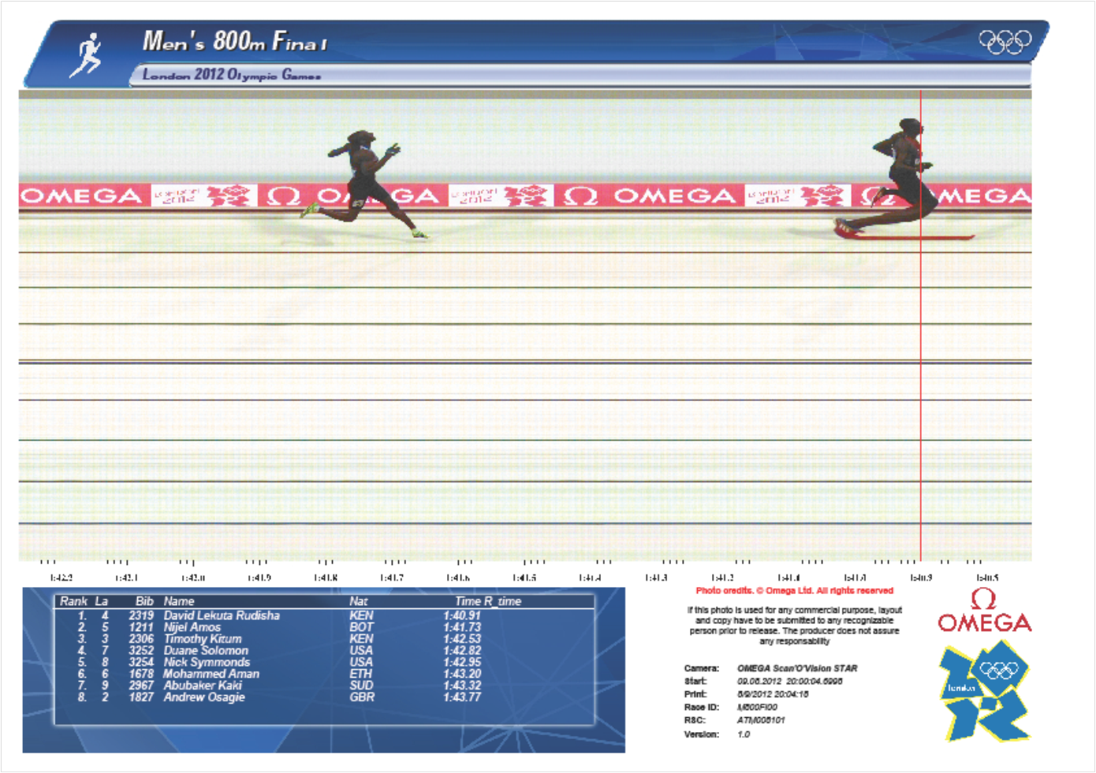
The Race (The Finish)
As mentioned before, WA and UKA rule 19.2 refers to :-
‘the time shall be taken to the moment at which any part of the torso of an athlete reaches the vertical plane of the nearer edge of the finish line’
As you can see from the photo opposite, the line indicates that moment the torso (not the leg or arm) reaches the front edge of the finish line.

Slide 9
The finish (trigger point)
As mentioned before, establishing a trigger point is essential. Using the finish line on its own can be a problem as it is the torso not the legs that matter. If you are high up in a stand it can be possible to use the line but more often you will be at ground level close to the finish.
So the next question is- how do we find our ‘trigger point’ to create our clear signal of when we ‘start to stop our watch’ at the finish of a race.
A number of things out of our control determine where our trigger point might be.
For example, where you are sat in relation to the finish line. Are we on it, before it or after it? How close are you to the track?
Rule 19.4 says :-
‘Timekeepers should be in line with the finish and placed at least 5m from the outside lane of the track’.
Sometimes this is not possible
Occasionally you have to change your trigger point maybe after feed back from the electronic times or times from other timekeepers.

Slide 10
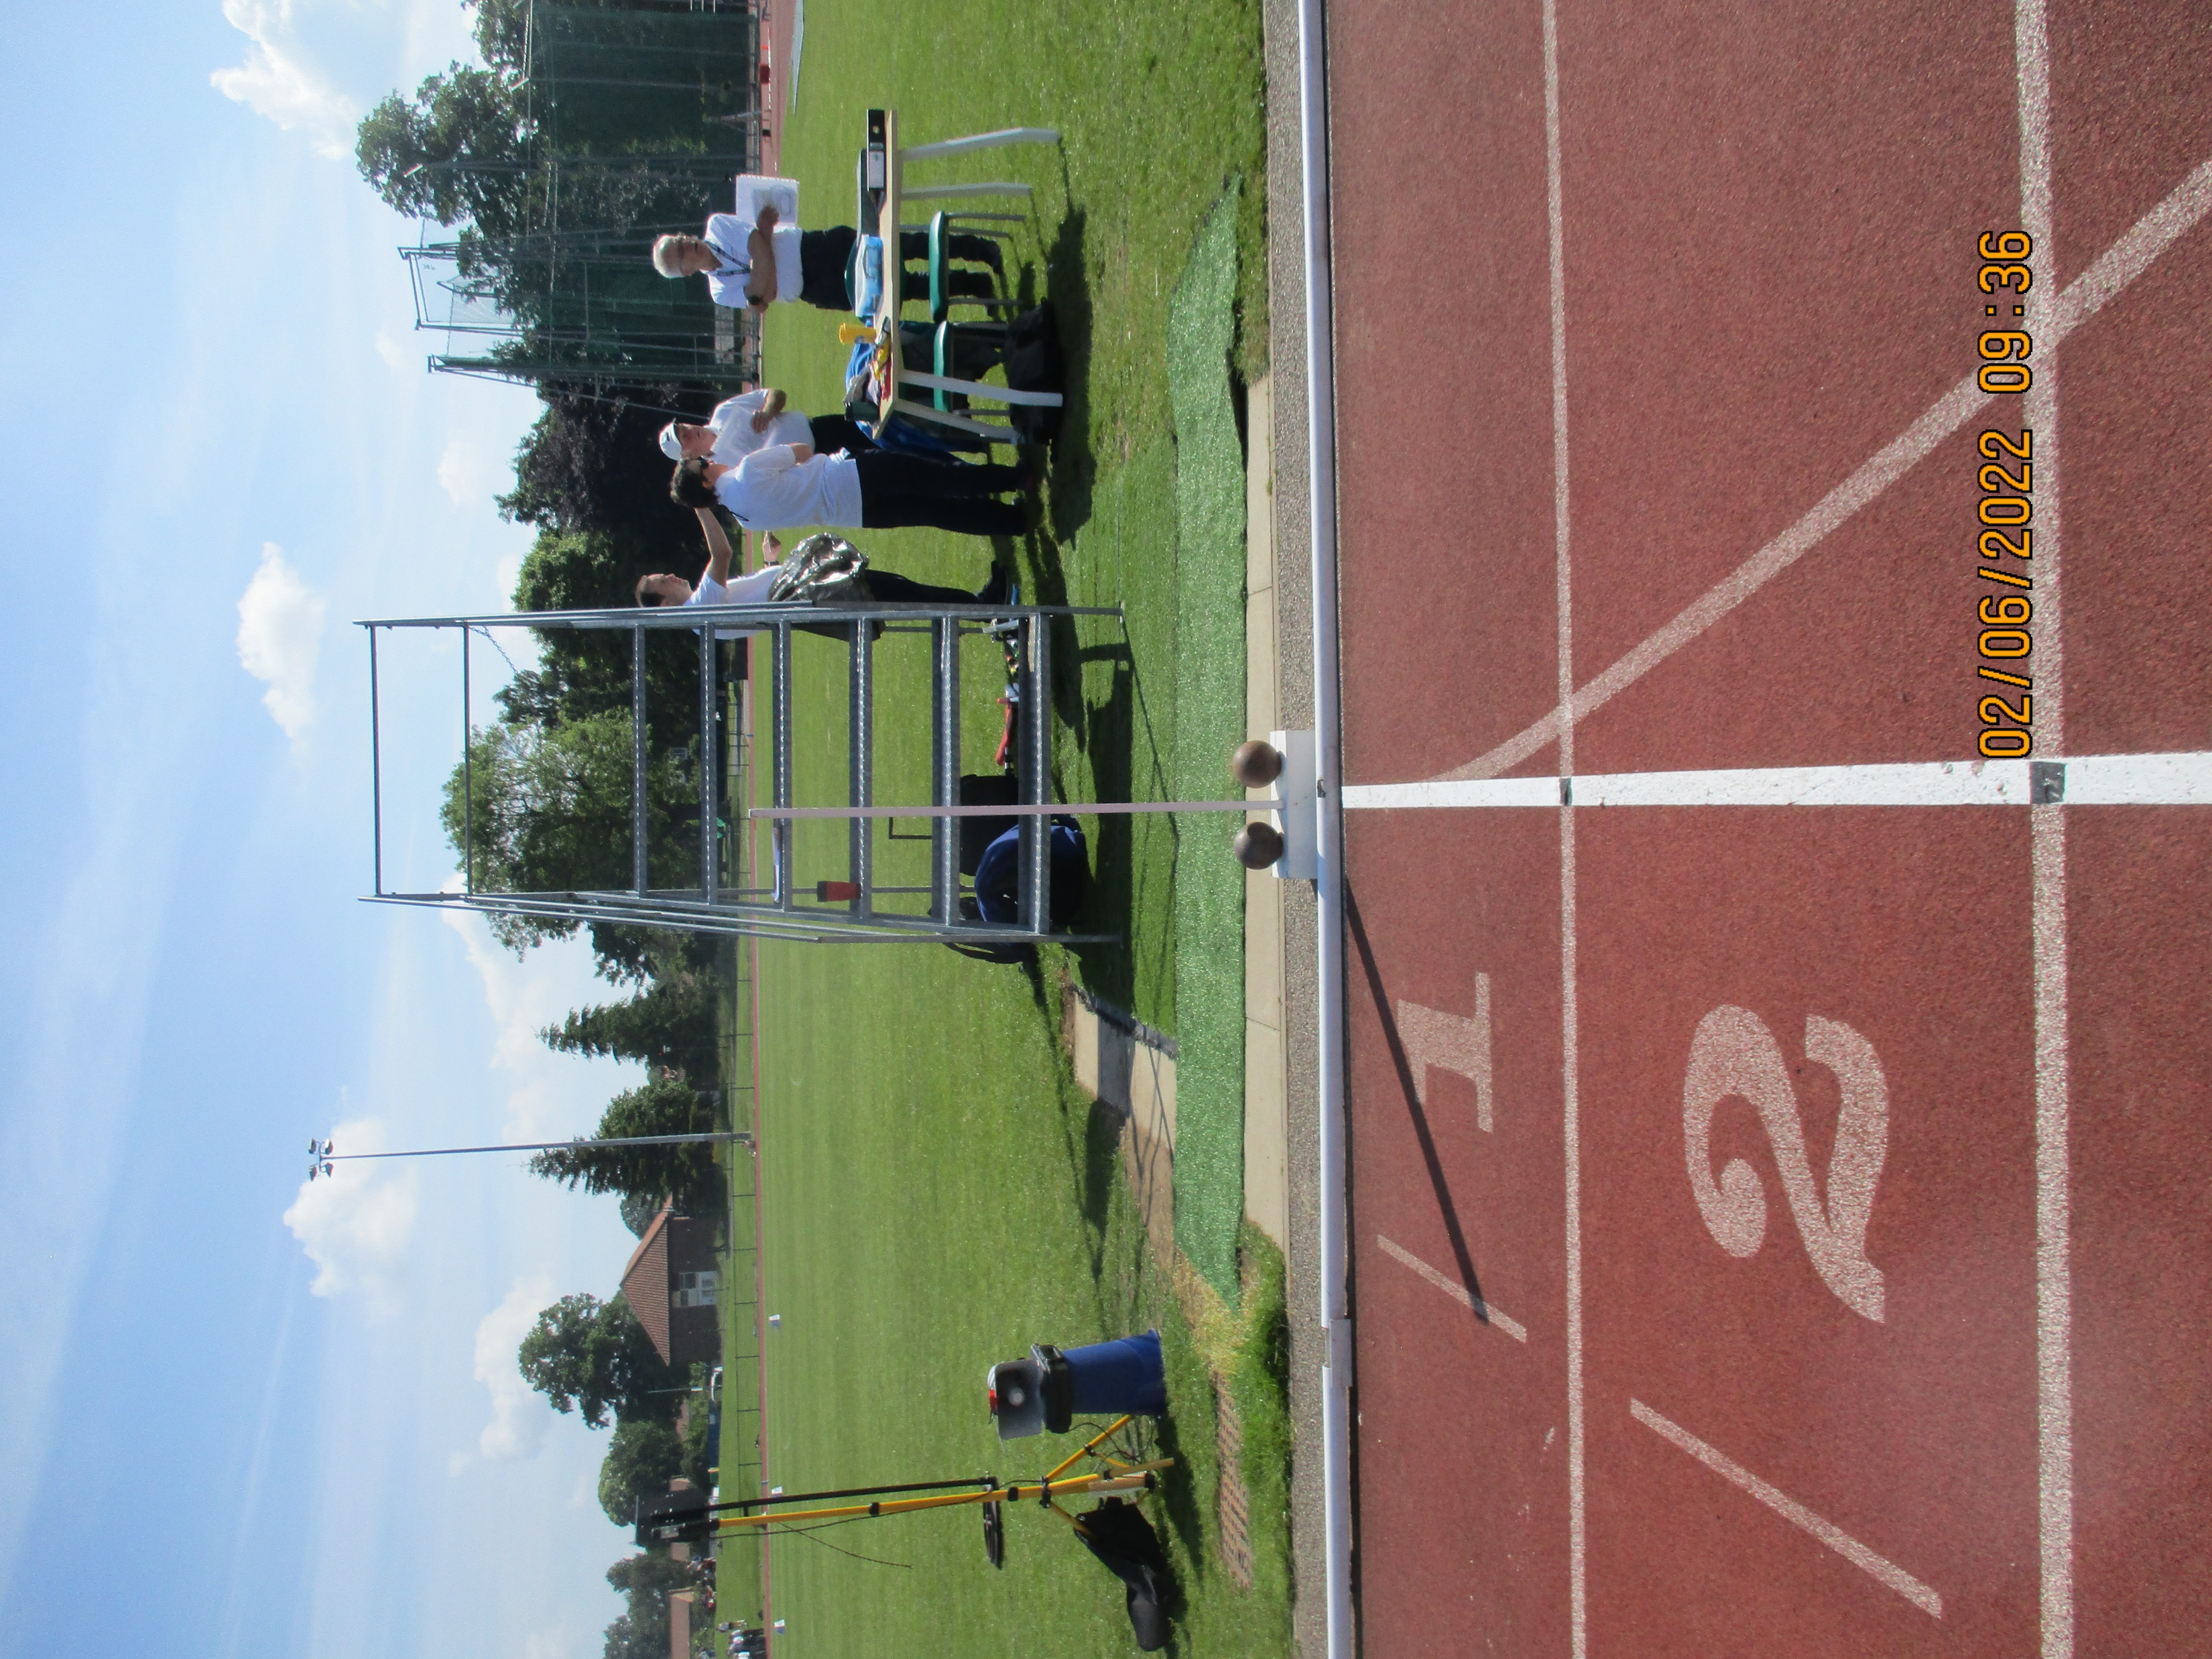
Finding your ‘Finish Trigger point’
This is very important.
Without a very good ‘trigger point’ that you are going to use as the signal to ‘start to stop your watch’ you are not going to be accurate.
As the picture opposite shows, there are various ‘items’ on the other side of the track (including the beam for the track side camera) which you can use as your ‘trigger point’. When the torso of your athlete hits your ‘trigger point’, that’s your signal to ‘start to stop your watch’.
The front edge of the white post (or board) in the picture is a very good point to use and the one you should aim to use.

Slide 11
A starting and finishing routine.
You are nervous. Every timekeeper gets nervous. You are working to such a small margin of error. The blink of an eyelid. That is why timekeeping is arguably the hardest discipline of them all. (Others disagree!)
You need a routine to calm your nerves and gain that elusive consistency of reaction to a clear signal. This is a possible routine:-
1. Place your watch into your left shoulder with your index finger poised on the start button. This solid position prevents movement of the watch when starting it, which can cause error.
2. As the gun goes up take a deep breath. This takes the tension out of the shoulders which makes you more relaxed. Remember it’s not the speed of your reaction but the consistency of it! React to the start signal.
3. As your athlete approaches the line, take another deep breath and relax. Keep an eye on your athlete ten or so metres out but then switch your attention to your trigger point and COUNT. It is a common mistake to follow your athlete to the line which commonly leads to a short time.
4. Keep your watch in your shoulder and simply press the stop button when your athlete hits your ‘trigger point’. Moving the watch in stopping it, possibly leads to errors.
5. Give your time to the Chief Timekeeper or the person you are working with, remembering to always ‘round up’ your time according to Rule 19.10.
6. Rule 19.11 indicates what to do if there is more than one timekeeper timing a particular position and the watches disagree.

Slide 12
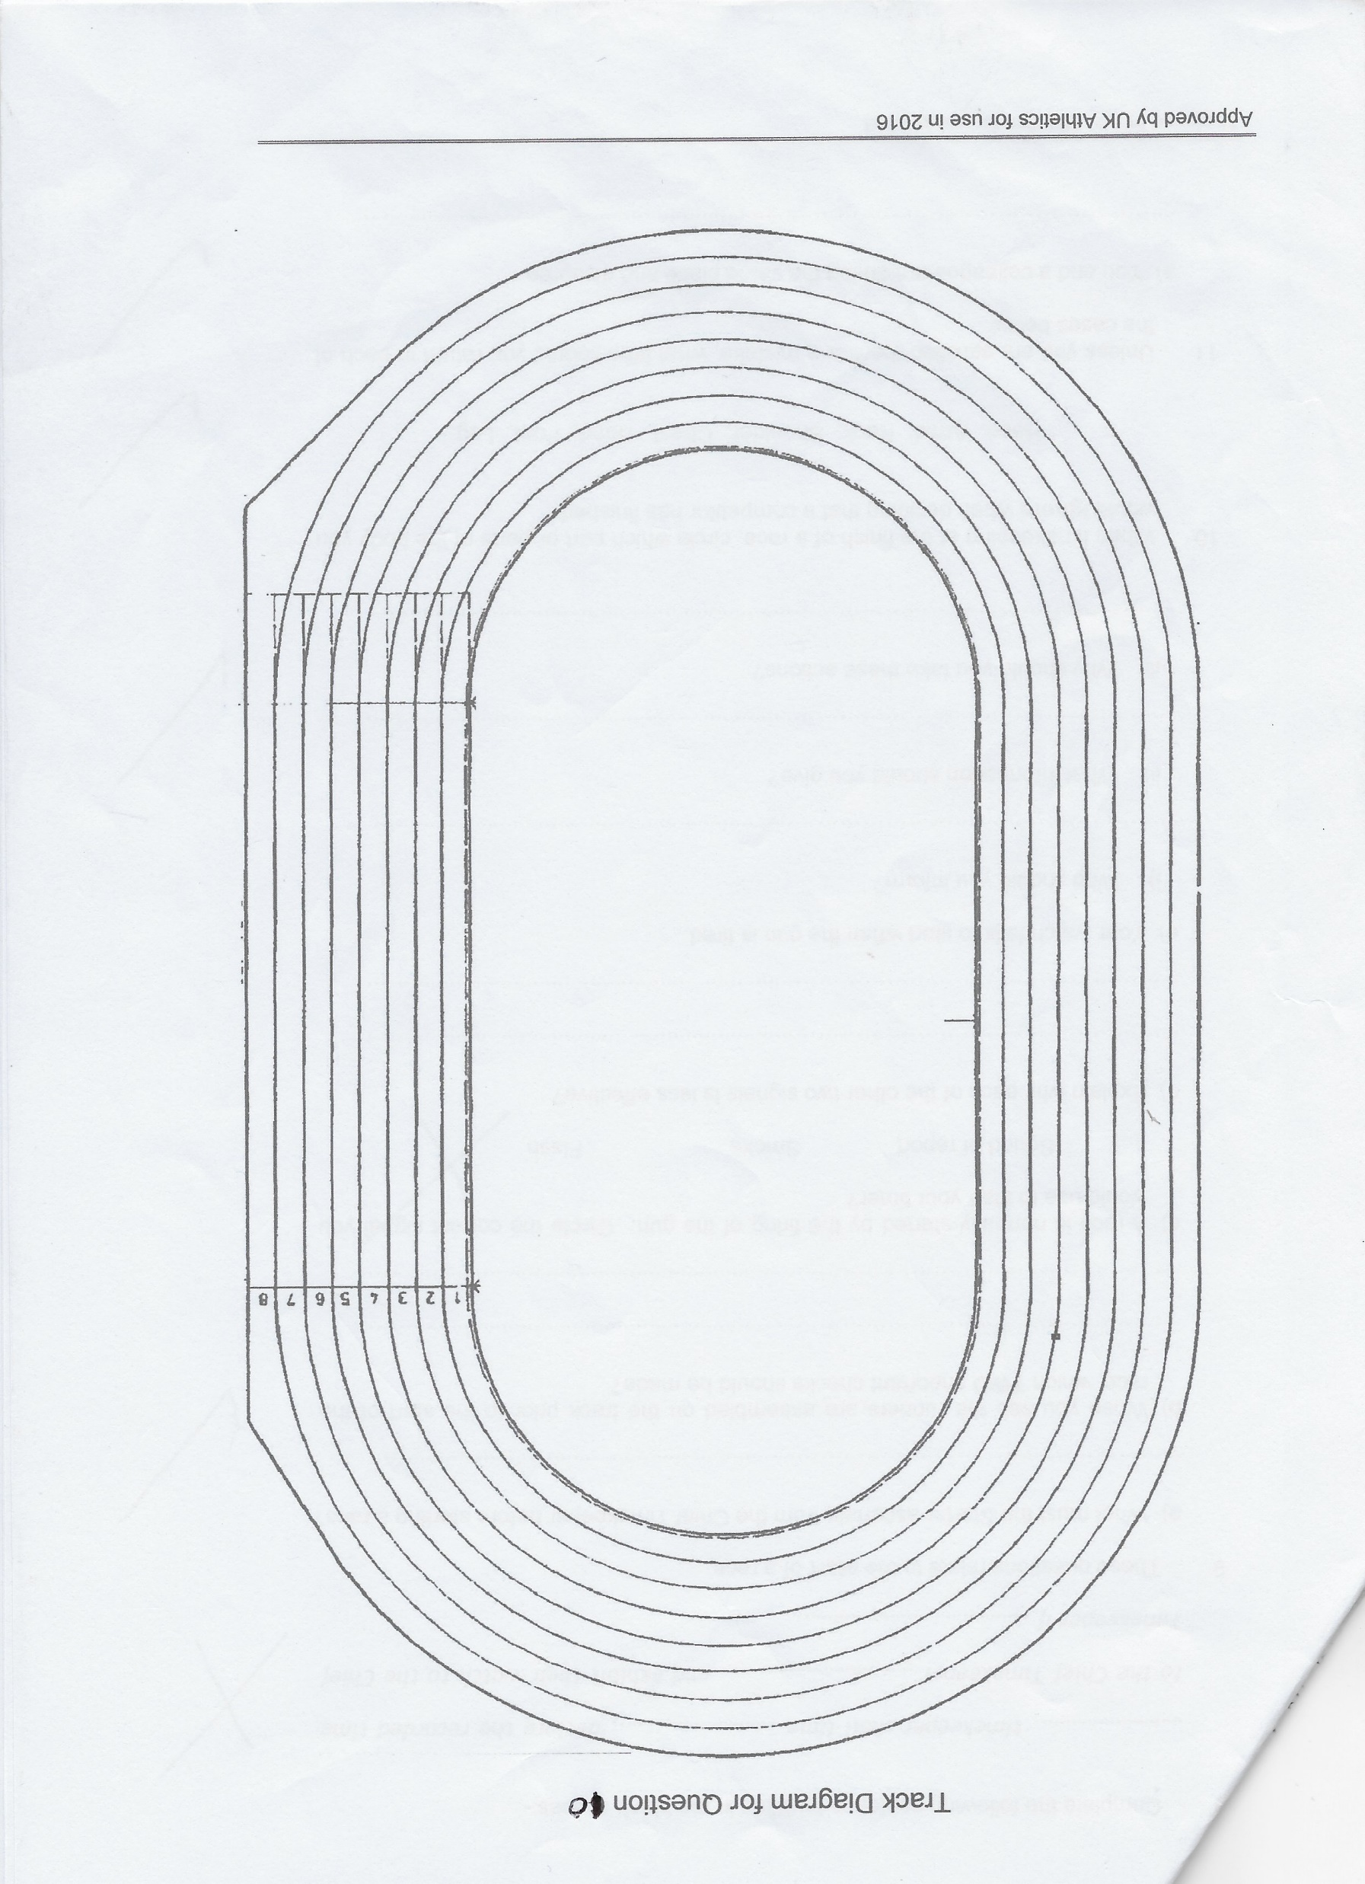
The Track positions for race starts
(excluding Steeplechase)
1500m
300m, 300m H
400m, 800m, 1200m, 400H, 10k, Relays
(80m, 80m H)
100m / 100m H
110m H
200m, 3k, 5k, (600m)

Slide 13
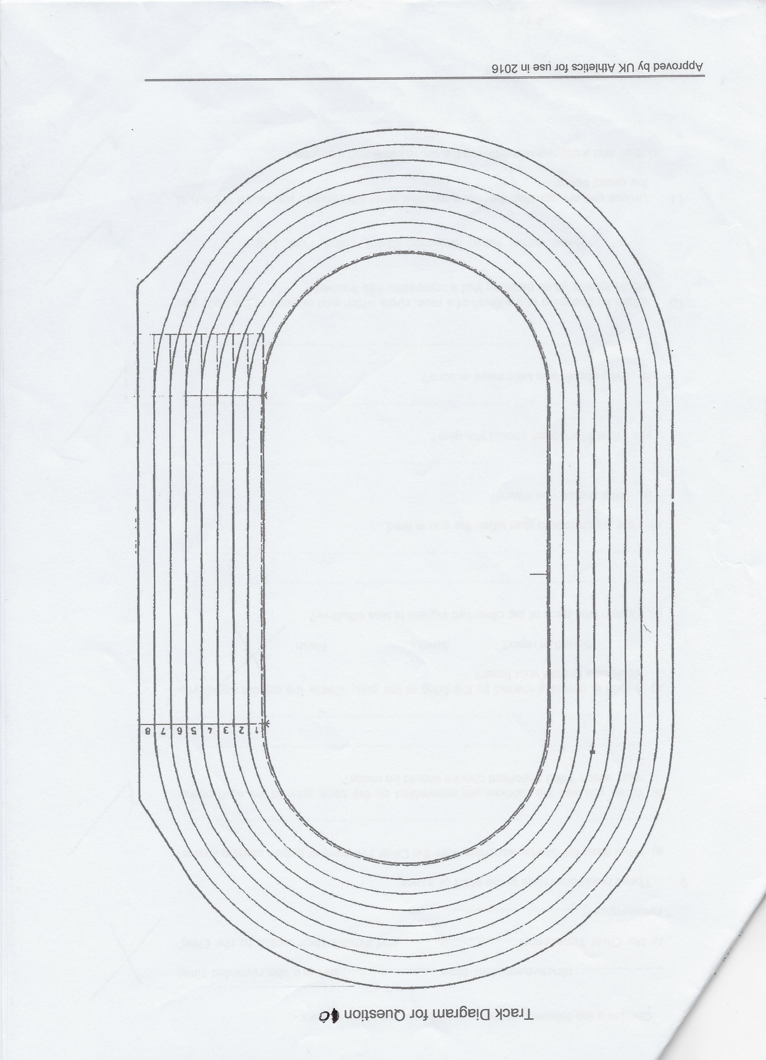
Steeplechase start positions
1500m
1500m
The start of every steeplechase (3k 2k or 1500m) is determined by whether the Water Jump is on the inside of the track or the outside.
The lines in blue are for an inside Water Jump and the lines in red for an outside.
There are tracks with the Water Jump is at the wrong end and the Timekeepers and Track Judges have to move!
2K
2k
3k
3k

Slide 14
Relevant timekeeping duties
By relevant I mean that at the level you are operating, there are certain duties you may be asked to do (there are others for Championships etc).
Calling Intermediate times
Point 6 of the Timekeepers’ Code of Practice explains the calling of intermediate times for the benefit of athletes. The Code of Practice is to be found on the UKA website. Briefly, for outdoor meetings, intermediate times in races of 800m or more are called at the start line for each lap and at the bell.
The exception to this rule is in the steeplechase races where the position of the Water Jump makes the laps variable distances. Therefore all steeplechase intermediate times are called at the finish line. On the first lap of any steeplechase the Chief Timekeeper will indicate whether or not the first time will be called. (As an example with an inside Water Jump in a 2k steeplechase the athletes have only run about 20m, whereas with a 1500m or 3k with an Inside Water Jump it may help the athletes’ pacing if we give them a time as they cross the finish line for the first time.)

Slide 15
Relevant Timekeeping duties
2. Recording Intermediate times
Rule 19.6 requires lap and intermediate times in races of 800m and over to be recorded. Essentially, this duty is done in case any National record is broken at a meeting. As this is unlikely at regional league meetings, this duty may not be required, but you could ask your Chief if you could practise.
3. Doing a lap chart
In longer races of 3k, 5k and 10k lapping may take place. The Chief Timekeeper may ask two timekeepers to do a lap chart to make sure that all competitors complete the required number of laps (The Track Judges will also do such a duty). One timekeeper calls the numbers of the athletes as they pass the finish line and the other writes them down on the lap chart.
Again ask the Chief if you can practise this duty if you feel up to it.
4. Taking your teams splits in a 4 x 400 relay
The slide at the end of this presentation tries to explain how this is done!

Slide 16
Relevant parts of the Timekeepers’ Code of Practice
The new Timekeepers’ Code of Practice is to be found on the UKA website and it’s important that you read this if at some later date you want to move up to Level 2. There are questions you must answer and submit about the Code and UKA Rules to reach Level 2.
The following is a brief list of those that you may need to be aware of at Level 1.
Point 1. Arrive at the track in good time so the Chief Timekeeper can assign positions to each timekeeper.
Point 2 & 3. It is very difficult for someone starting out on the timekeeping journey to take two accurate times in a sprint race, however you may be asked to take a second time in races of 800m and over. Ask your Chief to show you how this can be done with the stopwatch that you have.

Slide 17
Relevant parts of the Timekeepers’ Code of Practice
Point 12.4 x 400 Relay splits
You may be asked to take your team splits in a 4 x 400m relay.
For a beginner this can be very daunting.
For relays starting on short staggers (starting on the 800m marks and breaking after 120m) the time for each athlete is taken as the baton passes the finish line. Although your stopwatch will help you, it is a matter of subtracting the previous split time from the one you have just taken.
Here is an example which might help!
Leg | Cumulative time | Split time
1 | 57.4 | 57.4
2 | 1.52.5 | 55.1
3 | 2.48.6 | 56.1
4 | 3.44.5 | 55.9
Watch said 57.38
Watch said 1.52.5 and split 55.03
Watch said 2.48.59 and split 56.18 but it must be 56.1 because tenths of splits 2 and 3 went from 5 to 6
Watch said 3.44.42 split of 55.83

Slide 18
And Finally!
Best of luck with your journey, should you wish to embark upon it.
We are desperately short of timekeepers in the UK and athletes deserve an accurate time for each of their performances.
It is a fabulous hobby with some great people doing it (but not enough at the moment!) They are not paid for their services and do it for the love of the sport and a desire to help the community who choose to participate in Athletics.
Every athlete deserves an accurate time for their performance
(and say this quietly) sometimes Photo-finish gets it wrong!

